Slide 1
Computer Organization
Micro Architecture Level
The Processor: Datapath and Control

Slide 2
Six Level Computer
LEVEL 5
Problem Oriented Language Level
(High Language Level)
Translation(Compiler)
LEVEL 4
Assembly Language Level
Translation(Assembler)
LEVEL 3
Operating System Machine Level
Partial Interpretation
(Operating System)
LEVEL 2
Instruction Set Architecture Level
Interpretation (Microprogram) /
Direct Execution (Hardwired)
LEVEL 1
Micro Architecture Level
Hardware
LEVEL 0
Digital Logic Level

Slide 3
GOAL: Datapath and control unit
Design a computer architecture
To support the defined ISA
To fetch and execute each instruction
Study of
Processor designs
• Single cycle
• Multiple cycle
• Pipelined

Slide 4
GOAL: Datapath and control unit
Study of
Datapath
• Basic components
• How a datapath is constructed?
• How the speed of the CPU is determined?
Control unit
• Why do we need control unit?
• How control unit relates instructions and datapath?
• Control unit design

Slide 5
Instruction Set Architecture (ISA)
A programmable system uses
A sequence of instructions to control its operation
A typical instruction specifies:
Operation to be performed
Operands to use
Where to place the result
Which instruction to execute next

Slide 6
Instruction Set Architecture (ISA) (cont.)
Instructions are stored in
RAM or ROM as a program
The addresses for instructions in a computer are provided by
A program counter (PC) that can
Count up
Load a new address based on an instruction and, optionally, status information

Slide 7
Instruction Set Architecture (ISA) (cont.)
Part of the Control Unit to execute an instruction
The PC and associated control logic
Executing an instruction –
Activating the necessary sequence of operations specified by the instruction
Controlled by the control unit and performed,
In the datapath
In the control unit
In external hardware such as memory or input/output

Slide 8
ISA: Instruction Format
A instruction consists of a bit vector
The fields of an instruction are subvectors representing specific functions and having specific binary codes defined
The format of an instruction defines the subvectors and their function
An ISA usually contains multiple formats

Slide 9
MIPS Instruction & instuction Formats
Simplified only for
Arithmetic-logic instructions : add, sub, and, or, slt
Memory-reference instructions : lw, sw
Control-flow instructions : beq, j
6 bits
5 bits
5 bits
5 bits
5 bits
6 bits
op
rs
rt
rd
shamt
funct
R-Format
6 bits
5 bits
5 bits
16 bits
op
rs
rt
offset
I-Format
6 bits
26 bits
J-Format
op
address
Notes:
‹#›

Slide 10
Implementing MIPS: the Fetch/Execute Cycle
High-level abstract view of fetch/execute implementation
use the program counter (PC) to read instruction address
fetch the instruction from memory and increment PC
use fields of the instruction to select registers to read
execute depending on the instruction
repeat…
Notes:
‹#›

Slide 11
Processor Implementation Styles
Single Cycle
Perform each instruction in 1 clock cycle
Clock cycle must be long enough for slowest instruction
Multi-Cycle
Break fetch/execute cycle into multiple steps
Perform 1 step in each clock cycle
Pipelined

Slide 12
Single Vs. Multi-Cycle Processor Machine
Cycle time = 20 ns
Cycle time = 5 ns
1 cycle
4 cycles
Load
Load
1 cycle
3 cycles
Add
Add
1 cycle
2 cycles
Beq
Beq
Time for a load, add, and beq = 60 ns 45 ns
In the Single cycle implementation, every instruction requires one cycle to complete, so cycle time = time taken for the slowest instruction
If the execution was broken into multiple (faster)
cycles, the shorter instructions can finish sooner
‹#›
Notes:
‹#›

Slide 13
Processor Implementation Styles
Single Cycle
Perform each instruction in 1 clock cycle
Clock cycle must be long enough for slowest instruction
Disadvantage: only as fast as the slowest instruction
Multi-Cycle
Break fetch/execute cycle into multiple steps
Perform 1 step in each clock cycle
Advantage: each instruction uses only as many cycles as it needs
Pipelined
Execute each instruction in multiple steps
Perform 1 step / instruction in each clock cycle

Slide 14
Processor Implementation Styles
Unpipelined
Start and finish a job before moving to the next
Jobs
Time
A
B
C
A
B
C
Break the job into smaller stages
A
B
C
A
B
C
Pipelined
Notes:
‹#›

Slide 15
Processor Implementation Styles
Single Cycle
Perform each instruction in 1 clock cycle
Clock cycle must be long enough for slowest instruction
Disadvantage: only as fast as the slowest instruction
Multi-Cycle
Break fetch/execute cycle into multiple steps
Perform 1 step in each clock cycle
Advantage: each instruction uses only as many cycles as it needs
Pipelined
Execute each instruction in multiple steps
Perform 1 step / instruction in each clock cycle
Process multiple instructions in parallel

Slide 16
Functional Elements
Two types of functional elements in the hardware:
Elements that operate on data
Called combinational elements
Elements that contain data
Called state or sequential elements
Notes:
‹#›

Slide 17
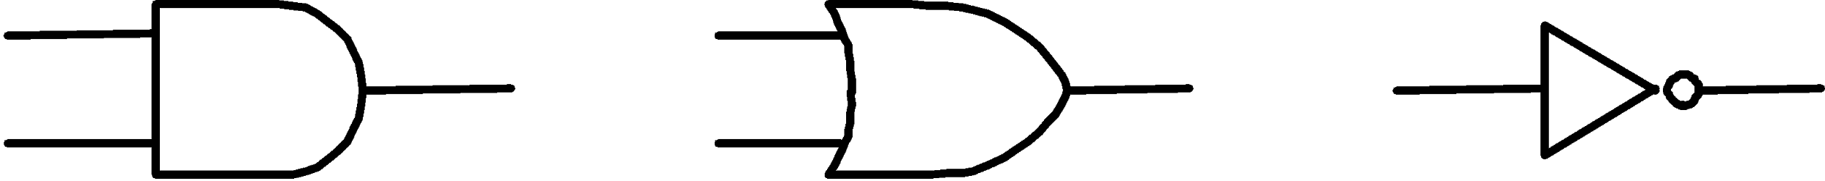
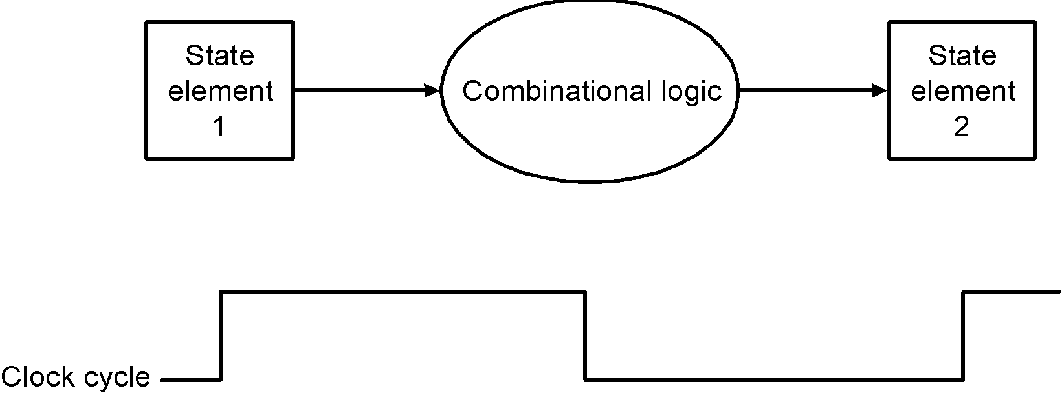
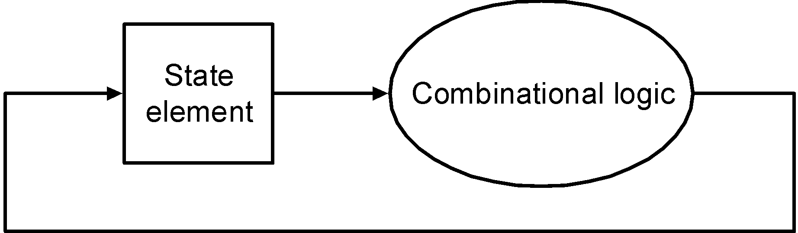
Combinational Elements
Works as an input ⇒ output function, e.g., ALU
Combinational logic reads input data from one register and writes output data to another, or same, register
read/write happens in a single cycle – combinational element cannot store data from one cycle to a future one
Combinational logic hardware units
Notes:
‹#›
Figure 2 shows the two state elements surrounding a block of combinational logic, which operates in a single clock cycle. All signal must propagate from state element 1 through the combinational logic, and to state element 2 in the time of one clock cycle. The time necessary for the signals to reach state element 2 defines the length of the clock cycle.

Slide 18
State Elements
Contain data in internal storage, e.g., registers and memory
All state elements together define the state of the machine
Flipflops and latches are 1-bit state elements, equivalently, they are 1-bit memories
The output(s) of a flipflop or latch always depends on the bit value stored, i.e., its state, and can be called 1/0 or high/low or true/false
The input to a flipflop or latch can change its state depending on whether it is clocked or not…

Slide 19
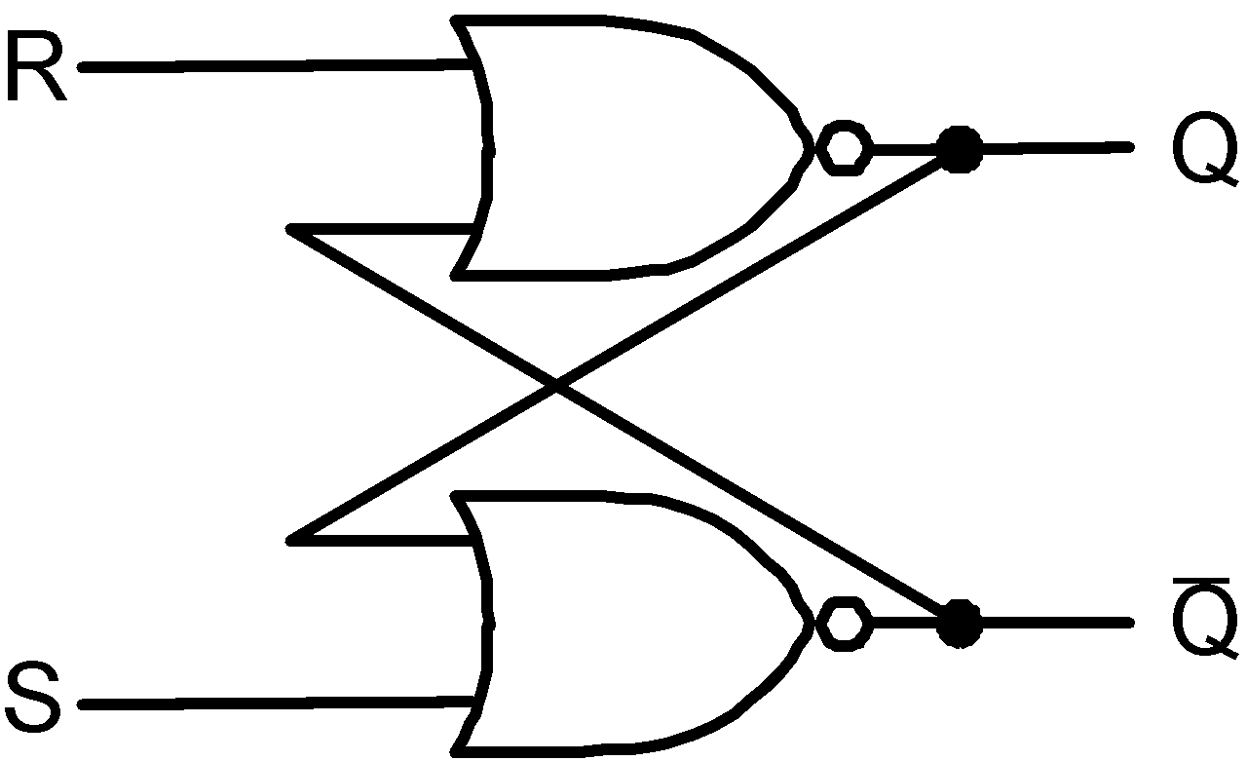
Set-Reset (SR-) latch (unclocked)
Basic memory unit
Made from two cross-coupled nand gates
When both Sbar and Rbar are 1, then either one
of the following two states is stable:
Q = 1 & Qbar = 0
Q = 0 & Qbar = 1
and the latch will continue in the current stable
state.
If Sbar changes to 0 (while Rbar remains at 1),
then the latch is forced to the exactly one
possible stable state (a). If Rbar changes to 0
(while Sbar remains at 1), the latch is forced to
the exactly one possible stable state (b).
So, the latch remembers which of Sbar or Rbar
was last 0 during the time they are both 1.
When both Sbar and Rbar are 0 the exactly one
stable state is Q = Qbar = 1. However, if after
that both Sbar and Rbar return to 1, the latch must
then jump non-deterministically to one of stable
states (a) or (b), which is undesirable behavior.
Think of Sbar as S, the inverse of set (which
sets Q to 1), and Rbar as R, the inverse of reset.
Sbar(set)
n1
Q
Rbar
(reset)
n2
Qbar
equivalently with nor gates

Slide 20
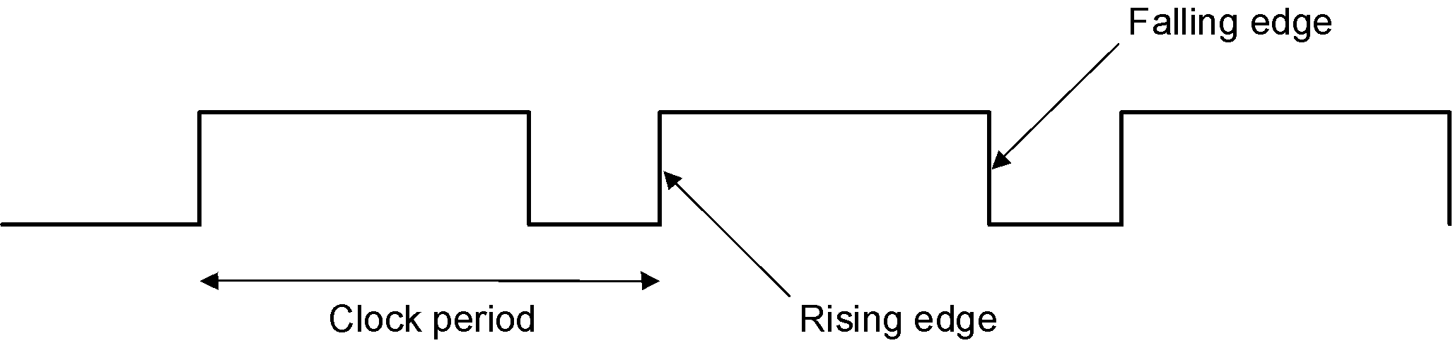
Synchronous Logic: Clocked Latches and Flipflops
Clocks are used in synchronous logic to determine when a state element is to be updated
in level-triggered clocking methodology either the state changes only when the clock is high or only when it is low (technology-dependent)
in edge-triggered clocking methodology either the rising edge or falling edge is active (depending on technology) – i.e., states change only on rising edges or only on falling edge
Latches are level-triggered
Flipflops are edge-triggered
Notes:
‹#›

Slide 21
Clocked SR-latch
State can change only when clock is high
Potential problem : both inputs Sbar = 0 & Rbar = 0 will cause non-deterministic behavior
Sbar
X
r1
n1
Q
clk
a
clkbar
Rbar
r2
n2
Qbar
Y

Slide 22
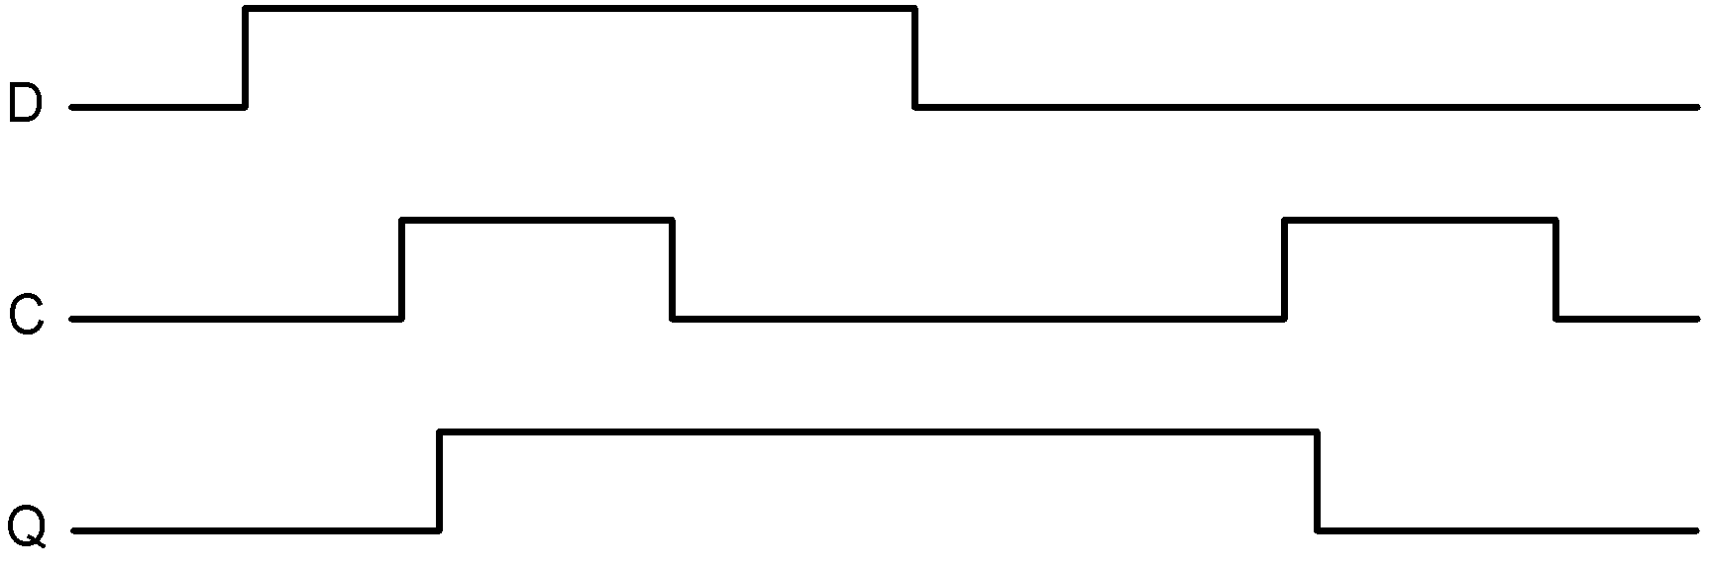
Clocked D-latch
State can change only when clock is high
Only single data input (compare SR-latch)
No problem with non-deterministic behavior
D
a2
Dbar
X
r1
n1
Q
clk
clkbar
a1
r2
n2
Qbar
Y
Timing diagram of D-latch
Notes:
‹#›

Slide 23
Clocked D-flipflop
Negative edge-triggered
Made from three SR-latches
sbar
clear
cbar
s
q
clkbar
clk
r
qbar
rbar
d

Slide 24
Logi Sim
All components that we have discussed – and shall discuss – can be fabricated using Logi Sim

Slide 25
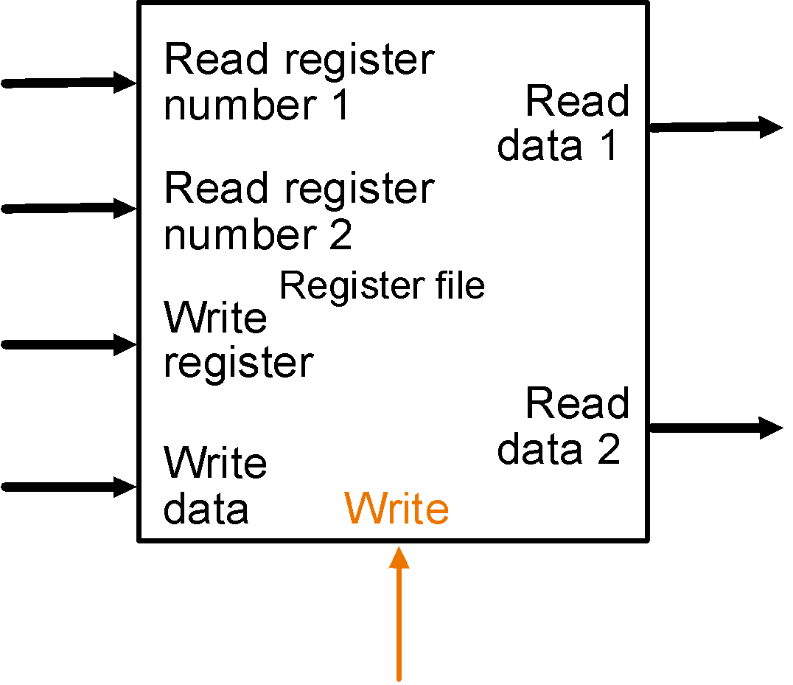
State Elements on the Datapath: Register File
Registers are implemented with arrays of D-flipflops
Clock
5 bits
32 bits
5 bits
5 bits
32 bits
32 bits
Control signal
Register file with two read ports and one write port
Notes:
‹#›

Slide 26
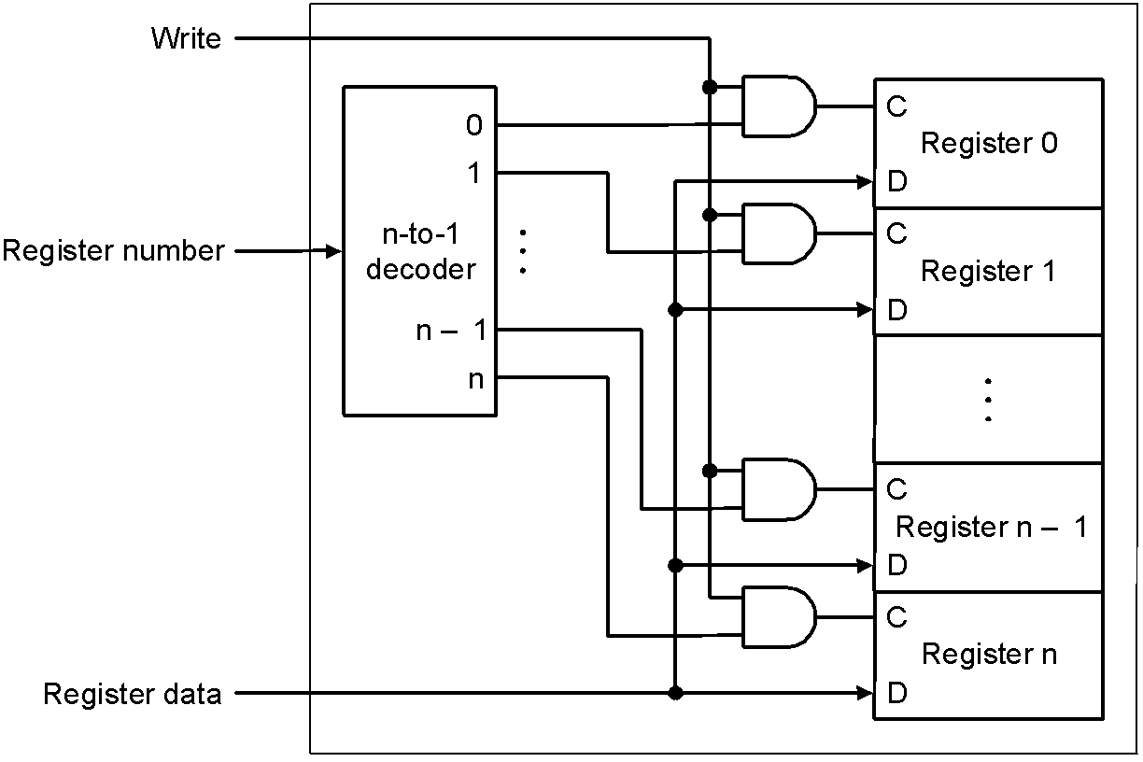
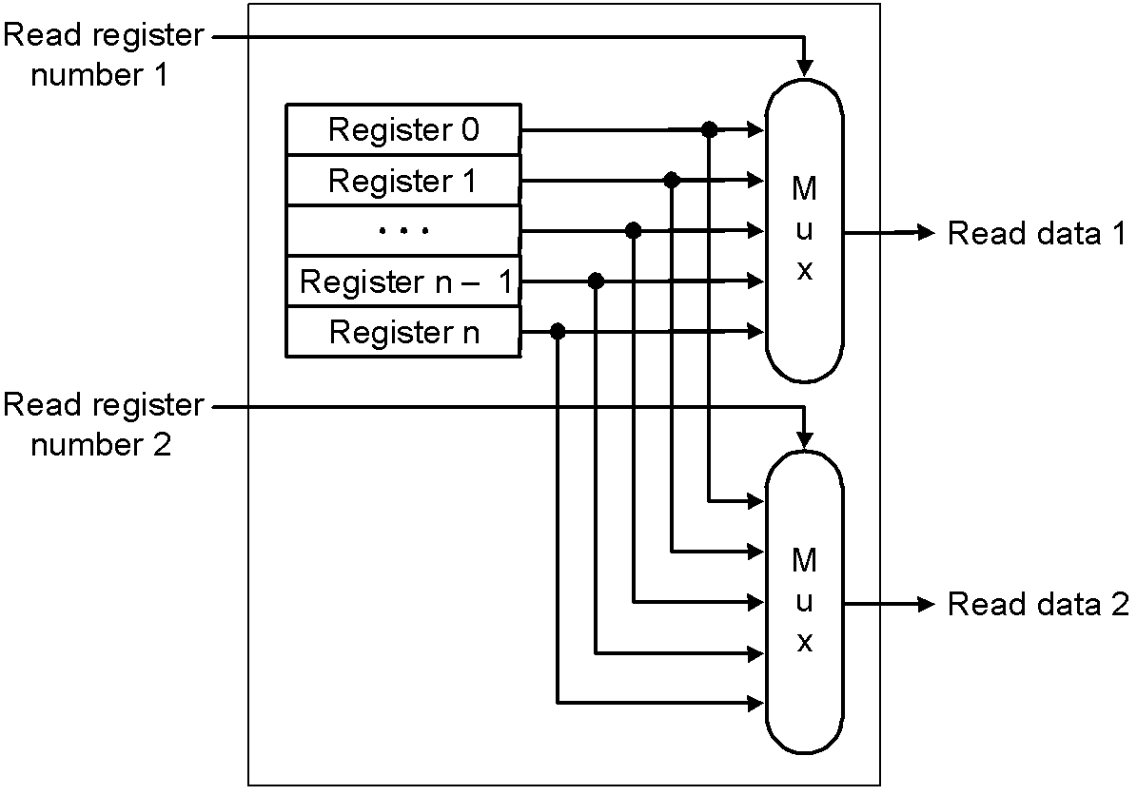
State Elements on the Datapath: Register File
Port implementation:
Clock
Clock
Read ports are implemented
with a pair of multiplexors – 5
bit multiplexors for 32 registers
Write port is implemented using
a decoder – 5-to-32 decoder for
32 registers. Clock is relevant to
write as register state may change
only at clock edge
Notes:
‹#›

Slide 27
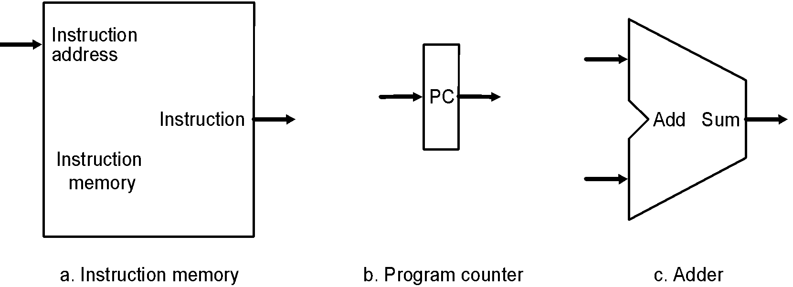
Datapath: Instruction Store/Fetch & PC Increment
Three elements used to store and fetch instructions and increment the PC
Notes:
‹#›

Slide 28
Datapath: Instruction Store/Fetch & PC Increment
Three elements used to store and fetch instructions and increment the PC
Notes:
‹#›

Slide 29
Datapath: Instruction Store/Fetch & PC Increment
Three elements used to store and fetch instructions and increment the PC
Notes:
‹#›

Slide 30
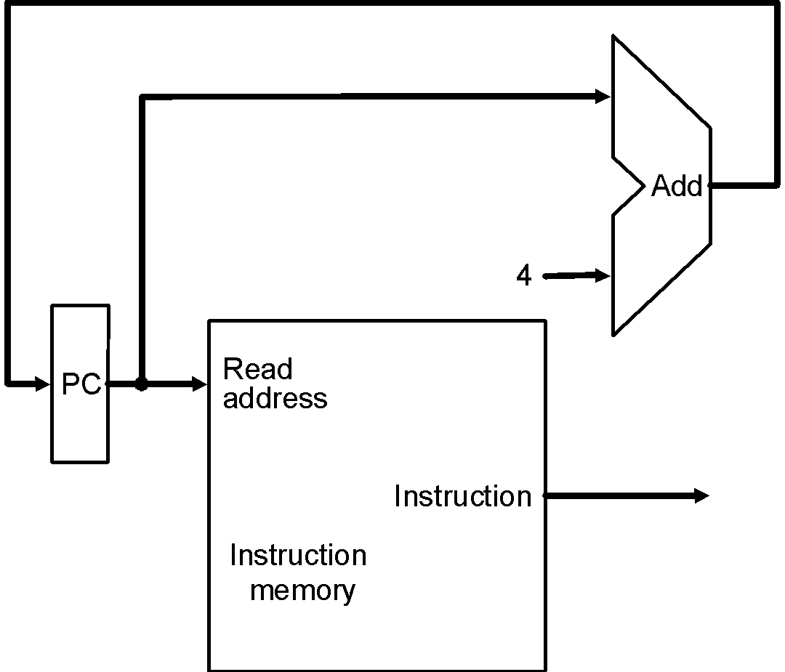
Datapath: Instruction Store/Fetch & PC Increment
Three elements used to store and fetch instructions and increment the PC
Datapath
Notes:
‹#›

Slide 31
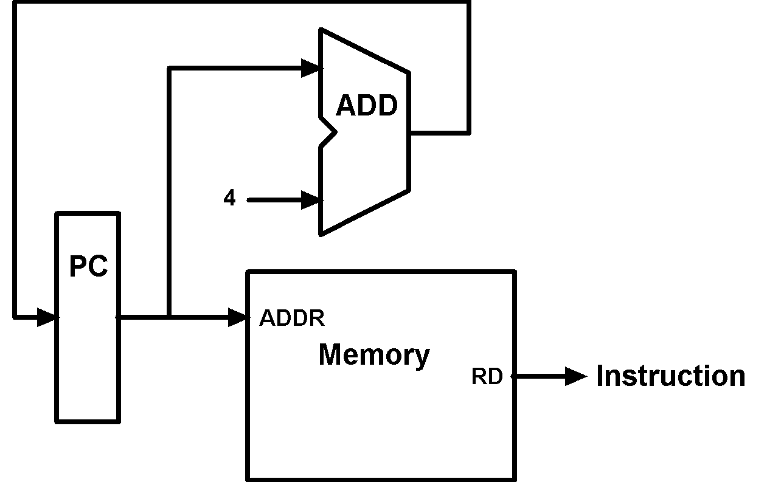
Animating the Datapath
Register Transfer Language (RTL)
Instruction 🡨 MEM[PC]
PC 🡨 PC + 4

Slide 32
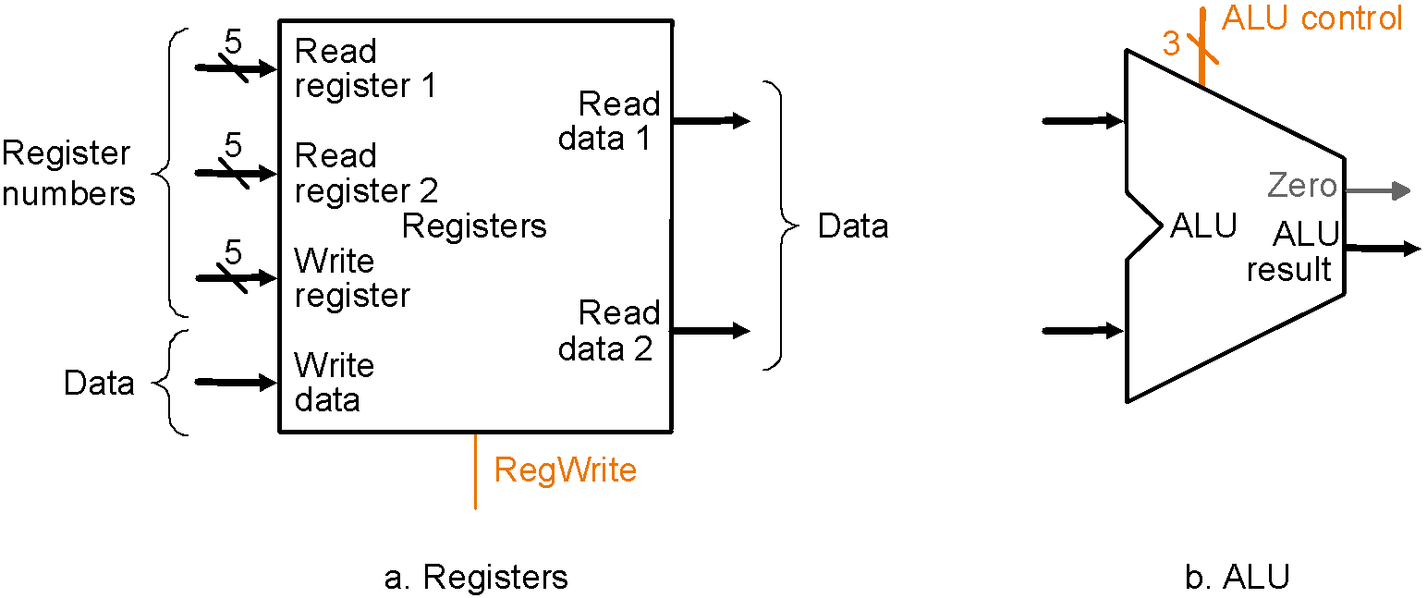
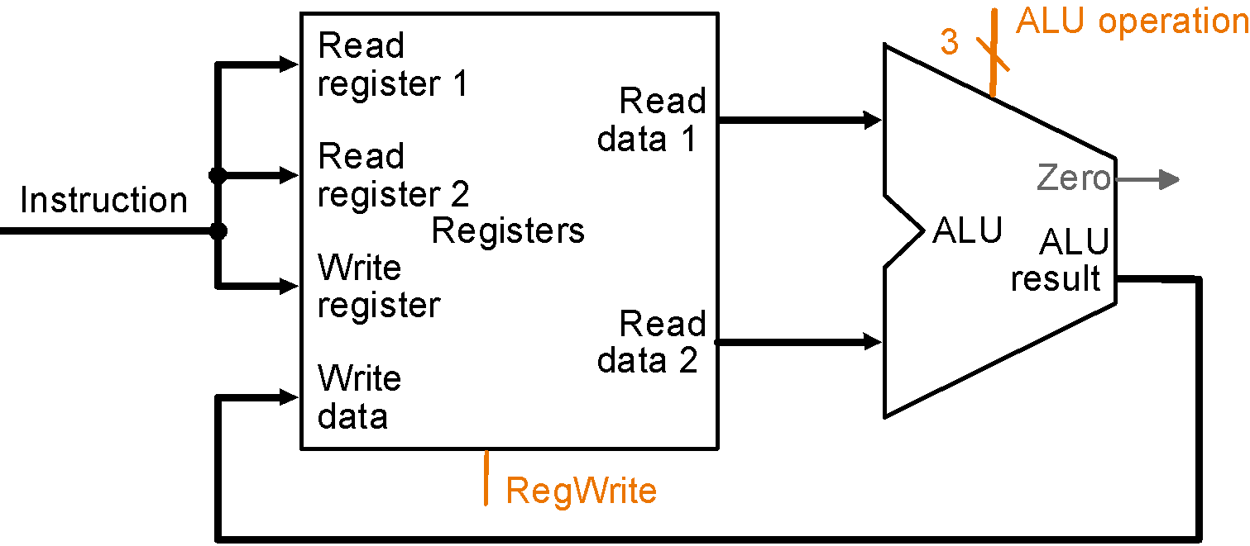
Datapath: R-Type Instruction
Two elements used to implement R-type instructions
Datapath

Slide 33
Datapath: R-Type Instruction
Two elements used to implement R-type instructions
Datapath

Slide 34
Datapath: R-Type Instruction
Two elements used to implement R-type instructions
Datapath

Slide 35
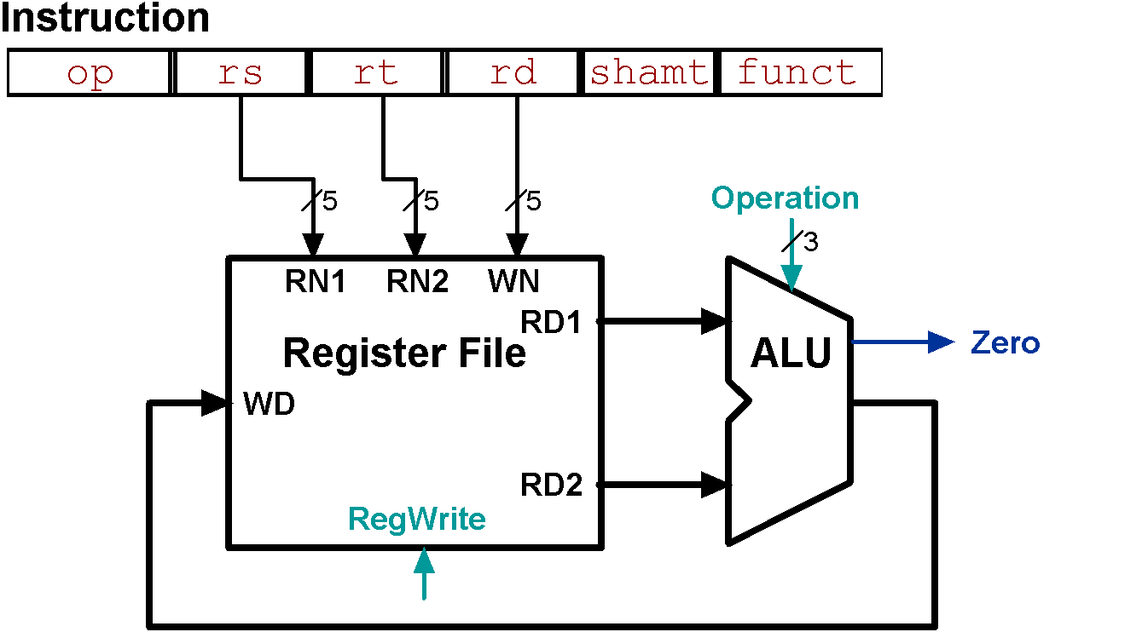
Animating the Datapath
add rd, rs, rt
R[rd] 🡨 R[rs] + R[rt];
Notes:
‹#›
WN : Write (Destination) Register Number
RN : Register No.
RD : Read Data
WD : Write Data

Slide 36
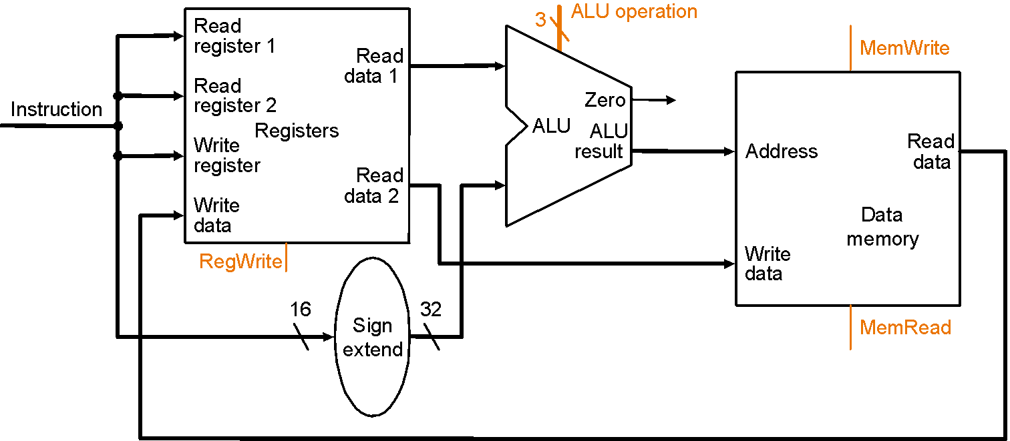
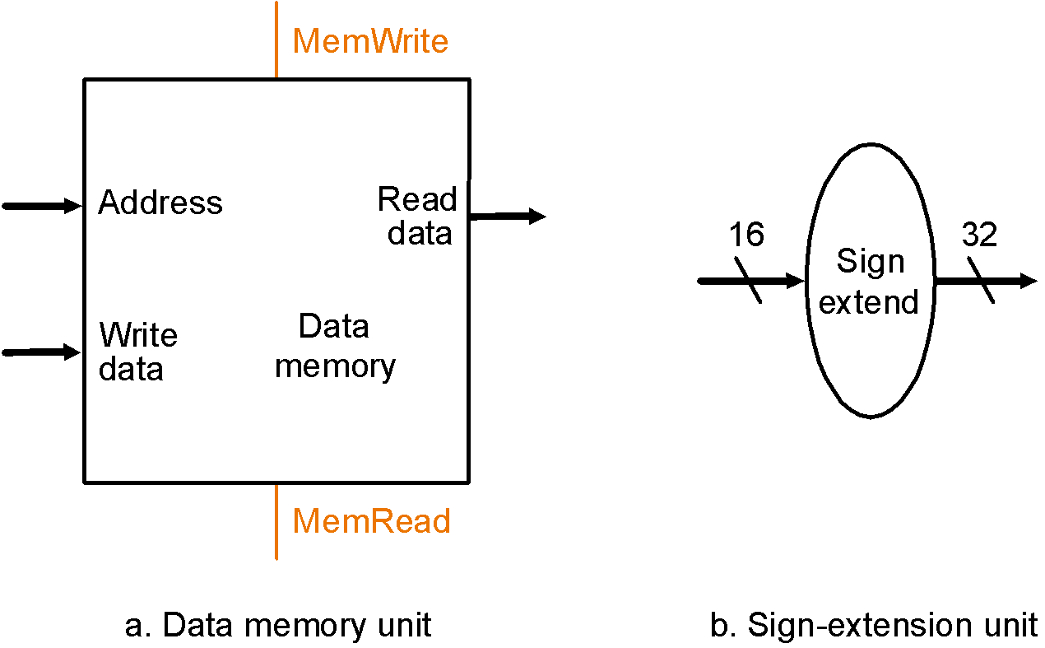
Datapath: Load/Store Instruction
Two additional elements used
To implement load/stores
Datapath

Slide 37
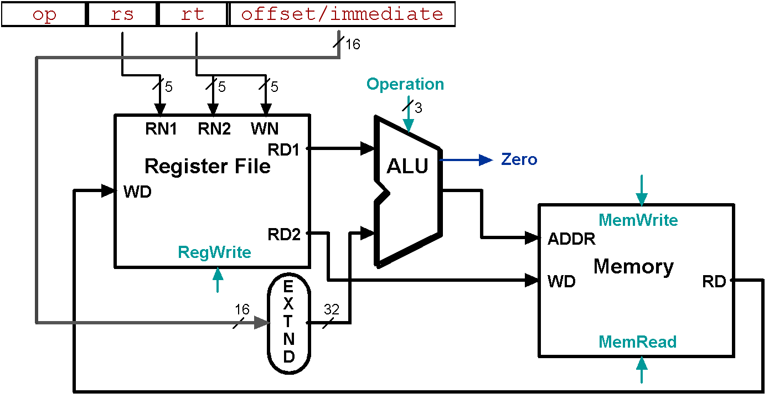
Animating the Datapath
lw rt, offset(rs)
R[rt] 🡨 MEM[R[rs] + s_extend(offset)];
Notes:
‹#›
WN : Write (Destination) Register Number
RN : Register No.
RD : Read Data
WD : Write Data

Slide 38
Animating the Datapath
sw rt, offset(rs)
MEM[R[rs] + sign_extend(offset)] 🡨 R[rt]

Slide 39
Next slides to be covered in lecture of 22 Sept 2020 by considering all components together…

Slide 40
Composing of the Elements
Each datapath element can only do one function at a time
Check possibility
Need separate instruction and data memories
Use multiplexers where alternate data sources are used for different instructions

Slide 41
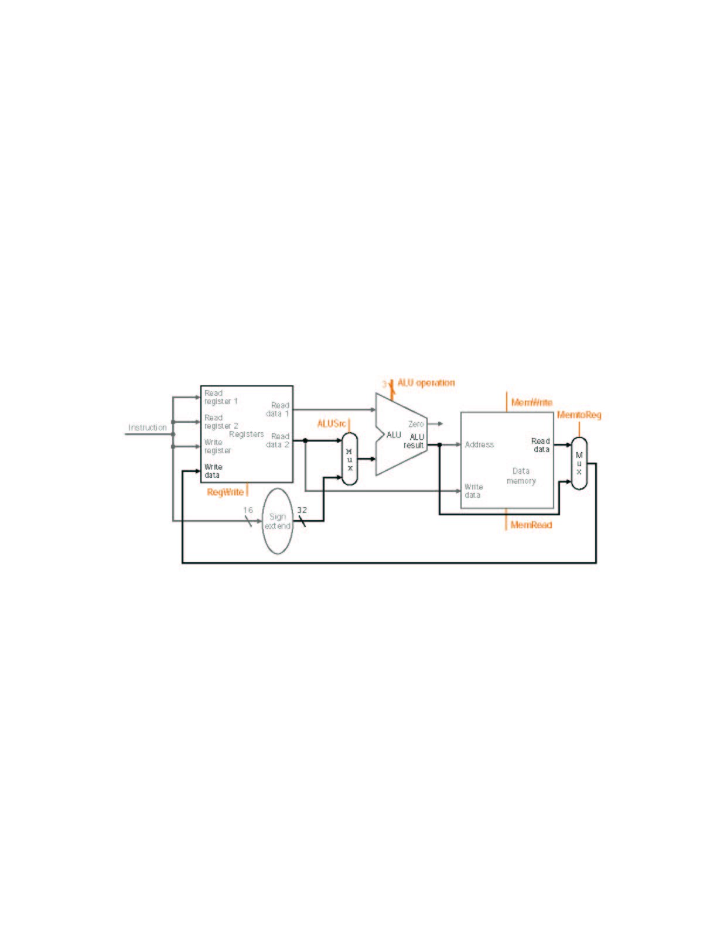
MIPS Datapath I: Single-Cycle
Input is either register (R-type) or sign-extended
lower half of instruction (load/store)
Data is either
from ALU (R-type)
or memory (load)
Combining the datapaths for R-type instructions
and load/stores using two multiplexors

Slide 42
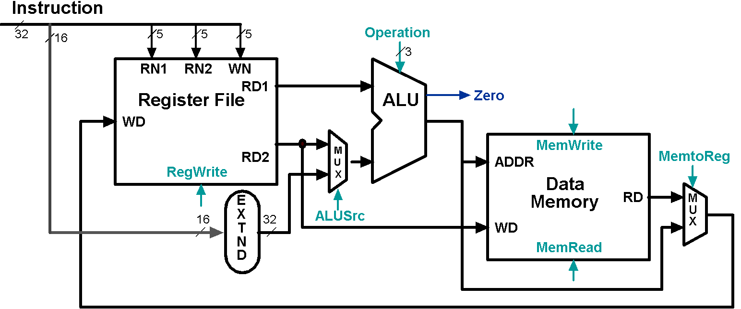
Animating the Datapath: R-type Instruction
add rd,rs,rt

Slide 43
Animating the Datapath: Load Instruction
lw rt,offset(rs)

Slide 44
Animating the Datapath: Store Instruction
sw rt,offset(rs)
Notes:
‹#›

Slide 45
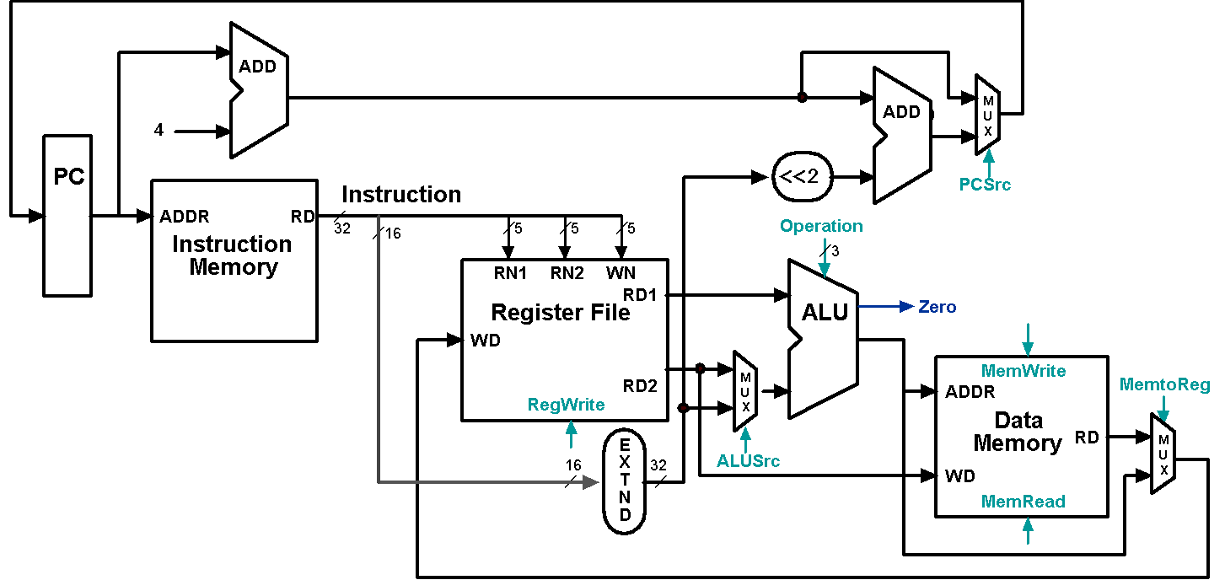
Datapath Executing add
add rd, rs, rt

Slide 46
Datapath Executing lw
lw rt,offset(rs)

Slide 47
Datapath Executing sw
sw rt,offset(rs)

